Slide 1
Naš Fond

Slide 2
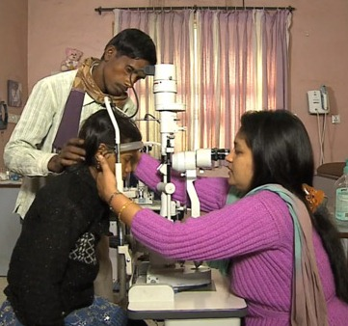
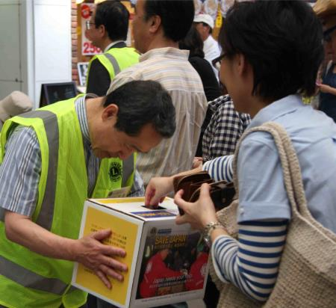
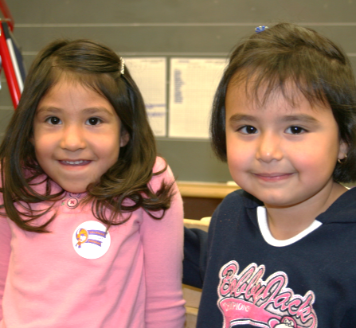
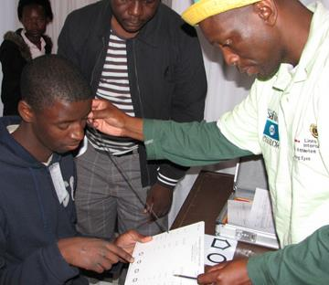
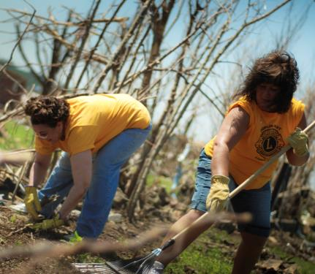
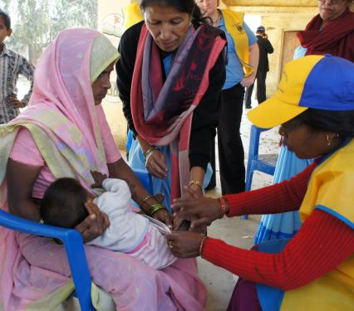
Što Vam pada na pamet kad mislite na LCIF?
Notes:
Before I begin, let me ask you – what comes to mind when you think of LCIF?
(see if people respond)
Some people would say disaster relief
Others might say saving sight
While others would say supporting youth, or the Lions Quest program
And, of course, measles vaccinations and meeting humanitarian needs
LCIF has programs to help Lions address very different needs.
Today we’ll review these programs and grants to help you become more familiar with LCIF, what it does for you, and why we should support our foundation. But, first, let’s share a bit of information about the foundation.
(Transition to LCIF at a Glance slide)

Slide 3
Ukratko o LCIF-u
Osnovan 1968. - službeni fond organizacije Lions Clubs International, daje potporu klubovima
Pruža financiranje za velike projekte
Ovisi o donacijama
Do sada donirano više od US$950 milijuna
Notes:
LCIF seems very simple – we receive money as donations, and we give money as grants, give support to clubs doing service in communities and in the world. And, the results are life-changing for so many people. LCIF provides grants for large-scale projects that clubs can’t do alone.
As a nonprofit organization, we rely 100% on donations from Lions and others. They donate to us because they share our mission.
So, it is very important to promote LCIF’s mission and values. Since 1968, LCIF has given out more than US$950 million in grants! Please think about the millions of lives that Lions have changed through these grants.
Our Foundation changes lives around the world.
And it is through four areas of service…
(Transition to next slide)

Slide 4
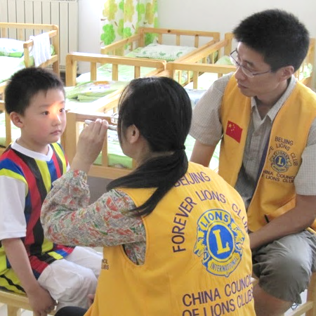
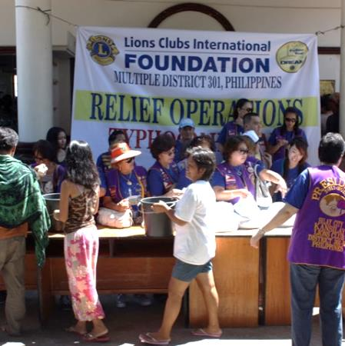
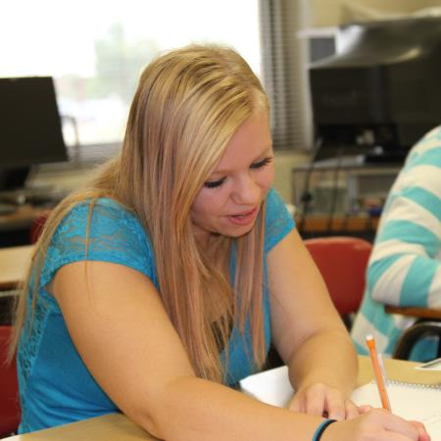
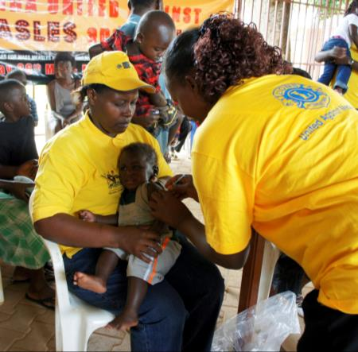
Vid
Katastrofe
Mladi
Humanitarno
Notes:
The first area of service is, PROVIDING DISASTER RELIEF. LCIF provides support around the world, and we constantly receive more and more requests.
The next area of service is SAVING SIGHT. Campaign SightFirst II was a huge success for LCIF. Thanks to that campaign, we are doing great service in this area, following our tradition.
LCIF also helps Lions SUPPORT YOUTH in many ways. Our most important youth program is the Lions Quest program.
Finally, LCIF helps Lions MEET HUMANITARIAN NEEDS in communities around the world. This includes global health issues, such as measles, diabetes prevention and education. We also support people with disabilities, and many other people in need.
(Transition to measles slide)

Slide 5
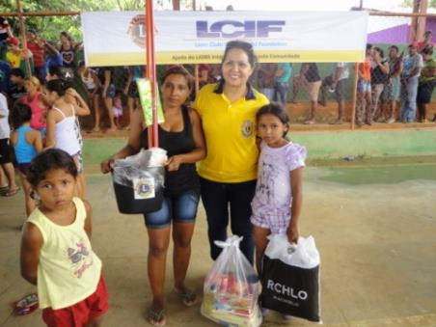
Pružanje pomoći kod prirodnih katastrofa
LCIF-ova prva financijska pomoć je bila za poplavljena područja
Financijski iznosi pružaju kratkoročnu i dugoročnu pomoć
Kontinuirana pomoć kod prirodnih katastrofa:
Filipini
Japan
Nepal
Turska
Notes:
Lions are members of the community. Following a natural disaster, Lions are able to quickly respond to the most immediate needs. Funding from LCIF enables Lions to meet urgent needs, such as food, medicine and clothing. The Foundation also supports long-term efforts to rebuild communities through housing and social service facilities.

Slide 6
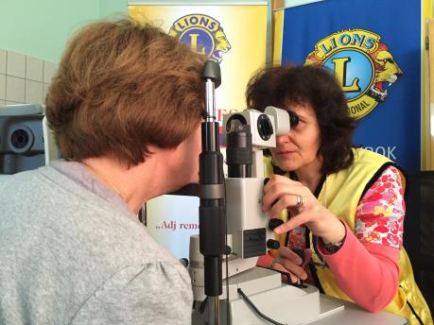
Očuvanje vida
Priznati lider u inicijativama vezanim na vid
Najnoviji projekti:
Opremanje „Lions sight center”
Proširenje pomoći za slijepe i slabovidne osobe
Program eliminacije riječnog sljepila
Uspostavljanje pomoći kod dijabetičke retinopatije
Notes:
Our foundation is a leader in supporting projects that prevent avoidable blindness and restore sight for people around the world. Additionally, LCIF supports initiatives that change the lives of those who are blind or visually impaired.
LCIF’s sight programs range from vision screenings to providing sight-restoring surgeries and treatments to expanding low vision services for underserved populations.

Slide 7
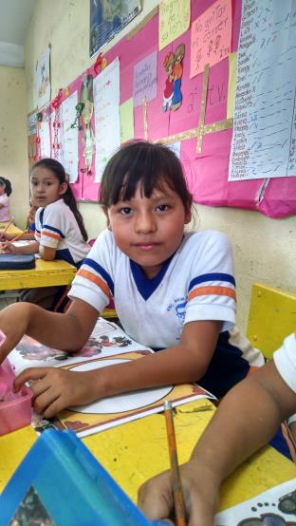
Podrška mladima
Izgradnja ili opremanje centara za mlade kao što su škole, sirotišta ili dnevna boravišta
Podrška profesionalnom školovanju mladih
Pružanje životnih vještina kroz Lions Quest program
Notes:
All over the world, Lions are bettering the future for children through improved education and health. LCIF supports Lions projects like building or equipping youth centers and expanding the Lions Quest program.
Lions Quest teaches young people important skills so they can work together, develop positive behaviors and make good choices. For more than 25 years, Lions Quest has brought positive change to the lives of children, their families and entire communities.
In every constitutional area, on every continent where Lions are active, Lions Quest has been implemented.

Slide 8
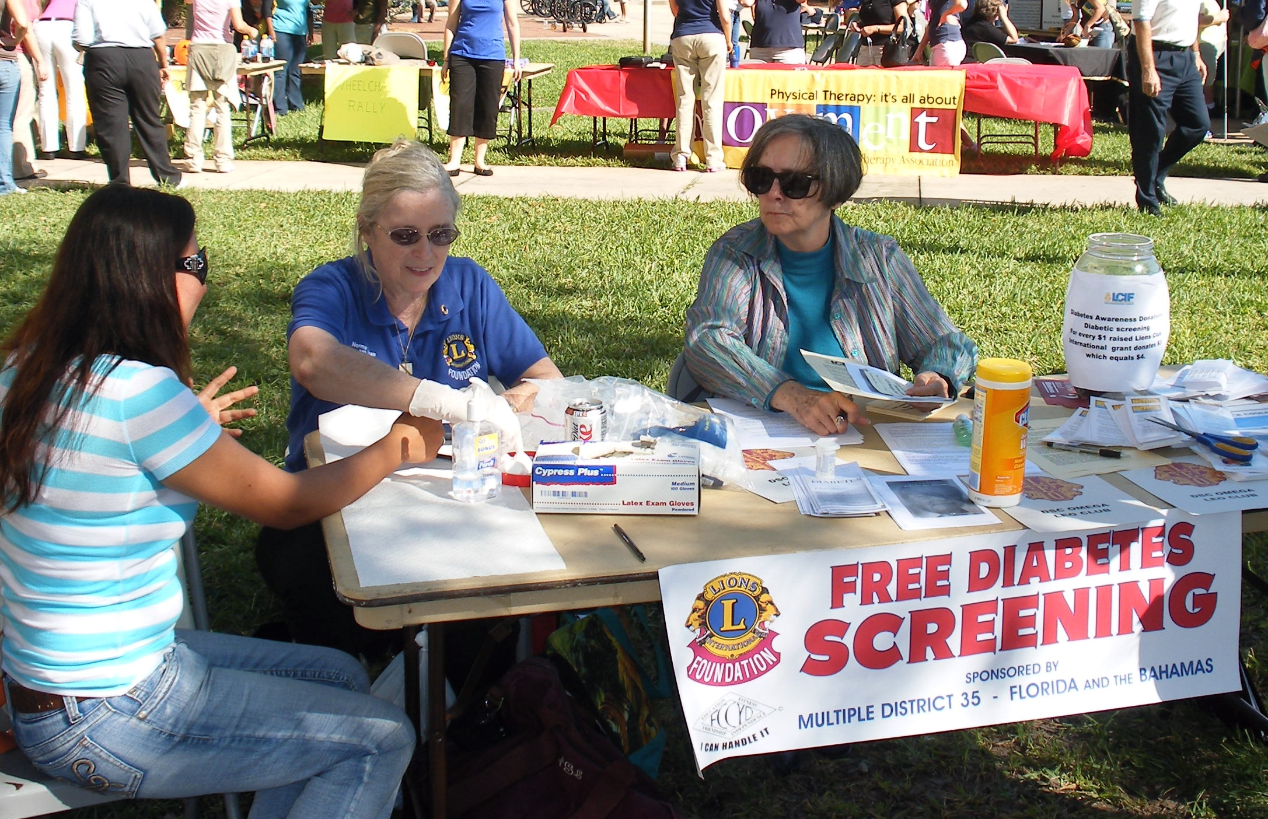
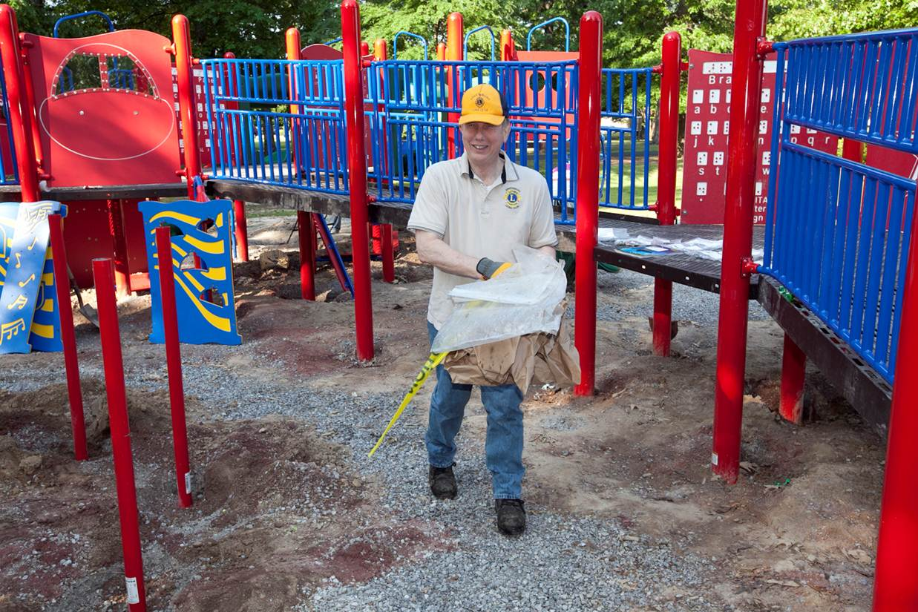
Zadovoljavanje humanitarnih potreba
Osposobljavanje hendikepiranih
Specijalna Olimpijada „Opening Eyes Partnership”
Igrališta za hendikepiranu djecu
Mikro poduzetništvo
Globalni zdravstveni problemi
Vakcinacija protiv ospica
Prevencija dijabetesa
Notes:
Humanitarian service is at the heart of LCIF and Lions service. Working together, Lions identify the most crucial needs, and LCIF supports them in projects that transform people’s lives around the world. We empower people with disabilities and are exploring the ways that we can make a difference through microenterprise. We also address global health issues such as measles, and diabetes prevention and education.
In 2010, Lions and LCIF recognized the importance of the fight against measles. Since becoming involved, Lions and our partners have helped to vaccinate more than 200 million children but the fight is not over.
(Transition to measles slide)

Slide 9
One Shot, One Life: Inicijativa Lionsa protiv ospica
400 ljudi svaki dan umre od ospica
Lions pružaju fizičku potporu društvenom mobilizacijom i zagovaranjem
Partnerstvo s Gavi-jem, „Vaccine Alliance” će prikupiti US$30 mil. za vakcinaciju protiv ospica do 2017.
Notes:
Today, I want to highlight our measles program, “One shot, one life. “
And most importantly – what YOU can do to support this program.
I am sure you have heard about this terrible number: 400 people die every day from measles. Most of them are children.
And even if they survive, they often have serious complications, including blindness. But we can prevent this, with just $1 for each child!
That is why we partnered with Gavi, The Vaccine Alliance. We made a commitment to raise $30 million by our centennial. By doing so, we are helping families around the world to live healthy and productive lives.
$30 million is a big amount of money. But, what if every Lions club donated 100 dollars per member to LCIF this year? We could raise US$140 million!
Do you think donating $100 is too difficult for our Lions? For some members, yes, but for many of them, not at all!
And, Lions can do more than giving money. Lions can also provide physical support for measles vaccination campaigns – we are in the communities in need – we can provide support around the world for vaccinations, through both donations and service.
(transition to grants)

Slide 10
Grant-ovi

Slide 11
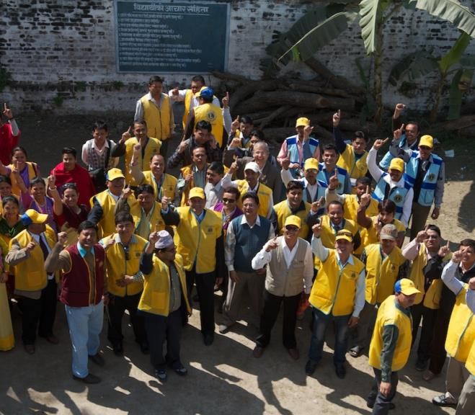
Kako LCIF pomaže Lionsima?
Pomaže Lionsima zajednički odgovoriti na humanitarne probleme u cijelom svijetu
Osposobljava Lionse da pomognu Lionsima
Financira projekte koji nadilaze potencijale distrikta/klubova
Razvija inicijative za financijsku pomoć kako bi pomogli Lionsima da bolje pomažu zajednici
Notes:
How does LCIF help us as Lions?
We respond collectively. We encourage Lions in one region to show their global friendship and help out Lions in another region during a time of calamity. We make possible what may be beyond the capacity of a single club or district. And, more and more often, we are giving service opportunities to Lions.
(Transition to types of grants)

Slide 12
Vrste Grantova
Vrste Grantova LCIF-a
Standard
Major Catastrophe
SightFirst
Core 4
International Assistance
Emergency
Notes:
As you can see, the foundation’s grants are grouped into six categories.
Standard Grants are the most common type of grant, awarded for large-scale Lions’ humanitarian projects. Grants must be for projects that serve a large number of people and are beyond the scope of a district or club to carry out alone.
Core 4 fund large-scale projects in specific areas related to Lions’ four core service commitments: preserving sight, combatting disability, promoting health, and serving youth.
International Assistance grants foster partnerships between Lions clubs in developed countries and those in less-developed regions. Grants can be used for projects such as medical missions, health care and clean water.
Emergency grants assist Lions in helping their community following a natural disaster. Funds must be used for immediate needs like food, water and clothing.
Major Catastrophe grants are awarded by the LCI President and the Chairperson of LCIF for major disasters. Lions do not apply for these grants.
SightFirst grants are awarded to fight preventable and reversible blindness. Grants can be used to build hospitals and clinics, train doctors, distribute medicine and raise awareness of eye-disease.
How many of you have been involved with a LCIF grant? (Lions raise hands)
Well, then some of you know already the great things we accomplish through the Foundation. Millions of people are served each year through a LCIF funded project. By supporting our Foundation our impact as Lions reaches beyond our own communities to our fellow Lions communities throughout the world. Your donation may help purchase vision screening equipment for your local eye screening project or it may support the expansion of a school in a community halfway around the world.
(Transition to Why Should Lions Support LCIF slide)

Slide 13
Naš utjecaj

Slide 14
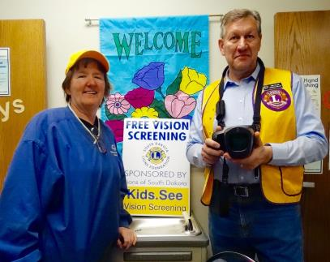
Zašto bi Lionsi podupirali LCIF?
LCIF je naša fondacija
Pomaže lokalnim i globalnim humanitarnim projektima Lionsa
Pomaže Lionsima realizirati velike projekte i inicijative
Igra jedinstvenu ulogu
Notes:
The Foundation is here to help Lions’ carryout large-scale projects or initiatives that clubs can’t easily fund on their own.
We play a unique role that is different from other nonprofits. While other organizations come into a community for a designated period and implement a project or provide assistance, Lions implementing our programs are residents and have a long-term investment in making the community stronger. We are still there long after the others have departed. That is unique and special and something few others can offer.
LCIF is supported by the generosity of Lions’ not by any of our membership fees.
I’m not going to ask you to raise your hand but how many of you made a gift to a charitable organization last year? My guess is, most of you. Now, how many of you made a personal gift to LCIF – your foundation? It supports your community, provides sight, supports youth, helps during times of disaster…all things Lions are passionate about.
You and your club can help support Lions’ projects all over the world through giving to LCIF. If you currently support LCIF, thank you. If you have never made a gift to the foundation, I would encourage you to consider LCIF.
(Transition to next slide)

Slide 15
Obogaćivanje života
MI SMO STRASTVENI I BRIŽNI - obogaćivanje života u zajednicama u cijelom svijetu!
Notes:
We are compassionate and caring – enriching lives in communities all over the world!
(Transition to question & answer slide)

Slide 16
Pitanja i Odgvori
Notes:
Thank you for your time today.
Any questions?
(transition to final slide)

Slide 17
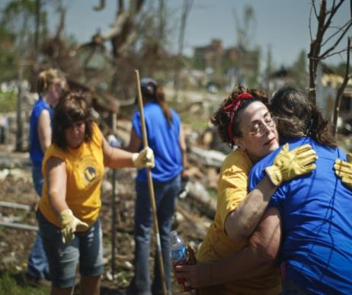
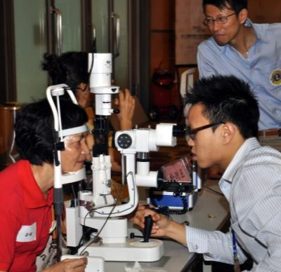
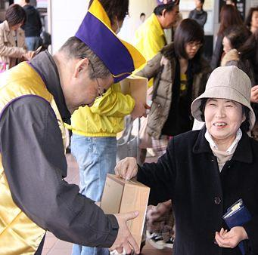
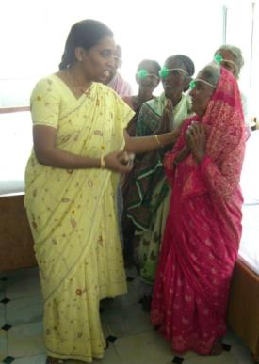
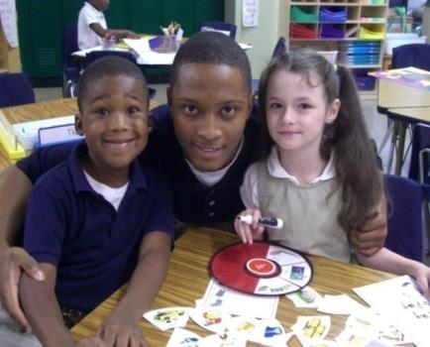
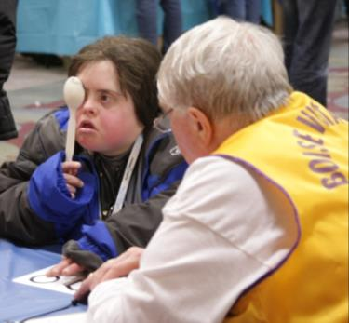
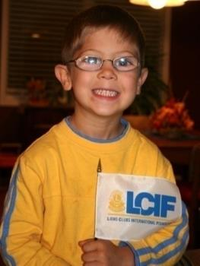
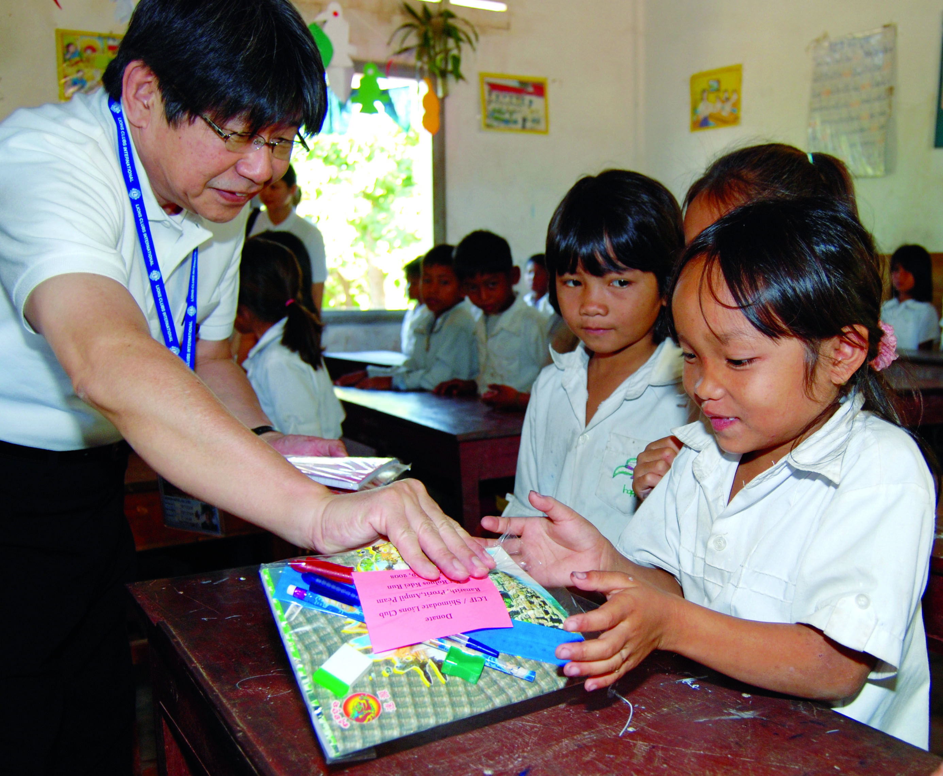
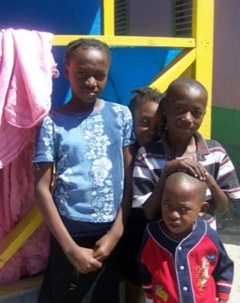
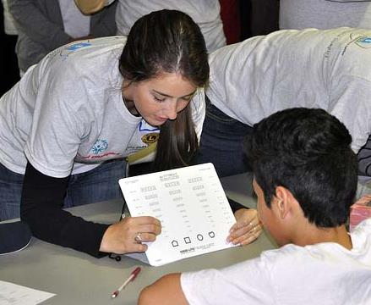
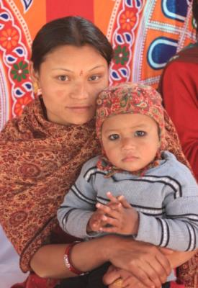
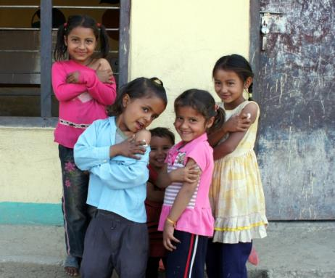
ZAHVALJUJEMO
NA VAŠEM DOPRINOSU!
Notes:
Thank you!

